Slide 1


Slide 2


RSSI-Based Gradient Descent Approach for Collaborative Robot Localization and Navigation
First Year
Submitted by
ROLL | NAME
2501940002 | Ram Kumar Singh
2501940014 | Shubham Goel
2501940019 | Jagdish Nayak
2501940055 | Tushar Singh
2501940065 | Vishakha Gaur
Faculty Mentor: Dr. Shweta Agarwal
Notes:
New Courses replaced with New Programmes

Slide 3

Project Overview
Collaborative robotic systems are being used more in places where GPS and maps are not available or are not working well. The usual ways of navigating often need a central control system or special equipment, which can limit how well the system can be scaled up and adapted. To deal with these problems, this project proposes a system where robots work together using a method called RSSI-based descent. This system lets multiple robots find each other and work together on their own in places.
The system uses something called Received Signal Strength Indicator values, which are gotten from communication between robots to figure out how close they are to each other. Each robot looks at the RSSI value. Uses a special algorithm to decide which way to move to get a stronger signal. By adjusting their movement based on changes in the RSSI, robots slowly move closer to each other and start working together without needing GPS or someone to supervise them.
This approach does not need a central control system, so each robot can make its own decisions about how to navigate. This makes the system more robust, able to handle robots and able to keep working even if some robots fail, all while keeping the hardware simple. The smart part of the system is mostly in the software, which optimises and makes decisions. The project shows that this method works through simulations and by building a version of the system, which makes it a good choice for things like navigating inside buildings, working with swarms of robots automating warehouses and searching for people in emergencies.
Notes:
New Courses replaced with New Programmes

Slide 4
Specific Objectives
To design and develop a GPS-free localization and navigation system for collaborative robots in indoor environments.
To utilize RSSI values as a feedback mechanism for estimating relative distances between robots.
To implement an RSSI-based distance estimation model for real-time proximity detection.
To develop and apply a gradient descent–based optimization algorithm for optimal movement and convergence.
To design a decentralized multi-robot framework enabling independent decision-making without a central controller.
To enable basic autonomous navigation, including movement control, obstacle detection, and decision-making.
To integrate low-cost hardware components such as ESP/NodeMCU and sensors for practical implementation.
To analyze RSSI variations and validate system performance through simulation and hardware experiments.
Notes:
New Courses replaced with New Programmes

Slide 5
Key Features
GPS-Free Localization: Operates in indoor and GPS-denied environments using RSSI signals without satellite dependence.
RSSI-Based Navigation and Distance Estimation: Uses wireless signal strength to estimate relative proximity and distances between robots.
Gradient Descent Optimization: Guides robot movement by iteratively maximizing RSSI for convergence toward the target.
Decentralized Control Architecture: Enables independent decision-making without a central controller, improving scalability and fault tolerance.
Collaborative Multi-Robot System: Supports inter-robot communication and data sharing for better coordination and accuracy.
Autonomous and Real-Time Operation: Allows continuous navigation, obstacle detection, and dynamic decision-making without human intervention.
Low-Cost, Scalable, and Flexible Design: Built using affordable hardware and easily extendable to multiple robots and larger environments.
Notes:
New Courses replaced with New Programmes

Slide 6
Progress Summary
The project has been successfully completed, achieving all planned objectives from system design to final testing and validation.
System Design Completed: Finalized architecture, algorithm design, and project requirements.
Hardware Implementation and Software Development : Fully assembled and integrated all components including ESP8266/NodeMCU, sensors, motor driver, and power system. Implemented RSSI-based navigation, obstacle detection, and MPU6050-based motion correction.
Gradient Descent Optimization: Successfully applied optimization logic to improve movement accuracy and convergence.
System Integration: Combined all modules into a single fully functional autonomous system.
Testing & Validation: Conducted indoor testing to evaluate accuracy, stability, and navigation performance.
Performance Achieved: Robot demonstrates reliable obstacle avoidance, stable movement, and effective RSSI-based navigation.
Documentation Completed: Prepared final report, PPT, synopsis, and research paper.
Notes:
New Courses replaced with New Programmes

Slide 7
Detailed Progress – Development Phase
At the final stage, the project has reached 100% completion, progressing from system design to full implementation and validation. The hardware system was successfully assembled, including the ESP8266/NodeMCU, motor driver, ultrasonic and IR sensors, MPU6050 IMU, and power components. Circuit integration and motor control were tested, enabling stable and controlled robot movement. On the software side, key modules were developed and integrated. WiFi communication was established to obtain RSSI values for navigation.
Obstacle detection using ultrasonic and IR sensors was implemented, and MPU6050-based motion correction was added to improve stability and direction control. All modules were then combined into a single system. RSSI-based navigation logic was implemented, allowing the robot to move toward the signal source. Gradient descent-based optimization was applied to improve movement accuracy and convergence. System performance was enhanced through parameter tuning to handle RSSI noise and environmental variations. Testing in indoor environments confirmed reliable obstacle avoidance, stable motion, and effective navigation. At completion, the robot operates autonomously, making real-time decisions using RSSI and sensor data, achieving accurate and stable navigation without GPS.
Notes:
New Courses replaced with New Programmes

Slide 8
Methodology
1. System Overview: A decentralized multi-robot system using RSSI values and gradient descent for GPS-free localization and navigation.
2. Data Acquisition: Robots collect RSSI, ultrasonic/IR sensor data, and IMU data for positioning, obstacle detection, and motion stability. Ultrasonic/IR sensors handle obstacle avoidance, while the IMU ensures stable and accurate motion.
3. RSSI-Based Estimation: RSSI values are converted into approximate distances using a path-loss model for relative localization.
4. Gradient-Based Navigation: Robots perform exploratory movements and apply gradient descent to move toward increasing RSSI and minimize error.
5. Iterative Process: Robots continuously sense → update → move, repeating until convergence to the signal source.
6. Integration & Validation: System implemented on ESP/NodeMCU with Arduino firmware and tested in indoor environments for accuracy and stability.
Notes:
New Courses replaced with New Programmes

Slide 9
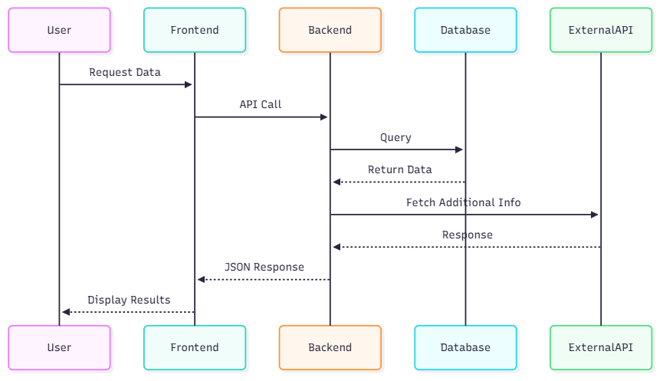
Prototype/Project Flow diagram/Architecture
Notes:
New Courses replaced with New Programmes

Slide 10
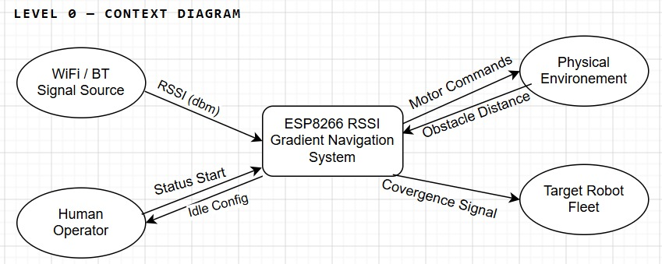
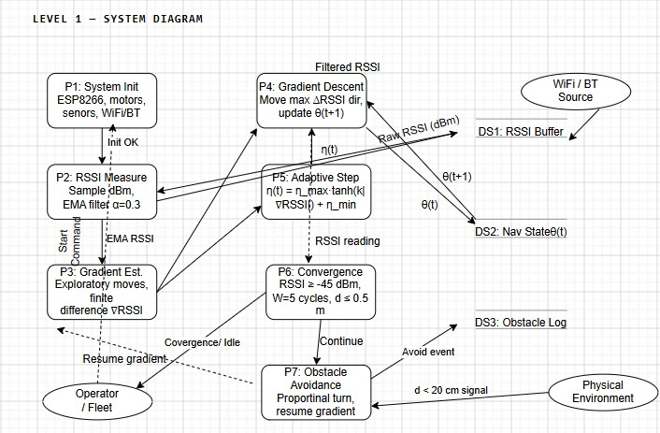
Prototype/Project Flow diagram/Architecture
Level 0 — Context Diagram
Shows the entire system as a single process bubble. External entities interact with the system at the highest level of abstraction. The system is the "ESP8266 RSSI Robot Navigation System."
Level 1 — System Diagram
Expands the single bubble into the 7 main processes from the flowchart. Data stores are introduced. All major inter-process data flows are shown.
Notes:
New Courses replaced with New Programmes

Slide 11
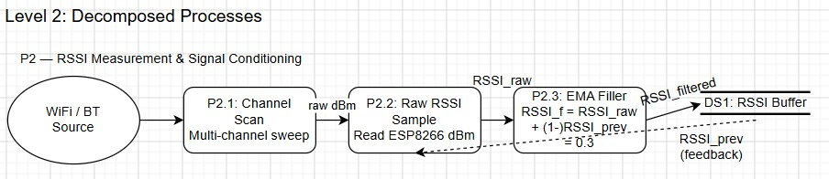
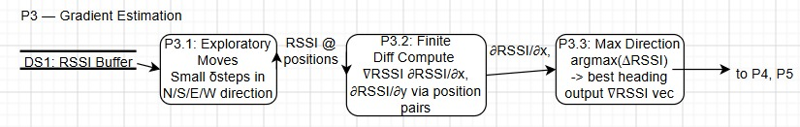
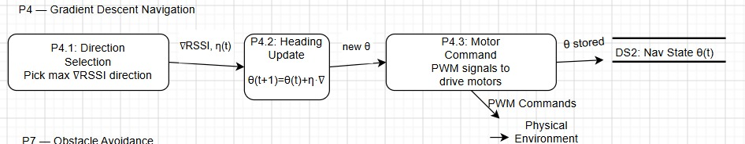
Prototype/Project Flow diagram/Architecture
Notes:
New Courses replaced with New Programmes

Slide 12
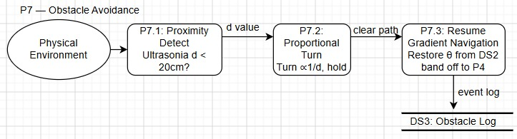
Prototype/Project Flow diagram/Architecture
Level 2 — Decomposed Processes
Explodes P2 (RSSI Measurement & Conditioning), P3 (Gradient Estimation), P4 (Navigation), and P7 (Obstacle Avoidance) into their sub-processes. These are the most complex processes in the system.
Notes:
New Courses replaced with New Programmes

Slide 13
Project Timeline
Phase | Phase Name | Weeks | Key Activities
Phase 1 | Problem Definition & Planning | Week 1-2 | System architecture design, component selection, and requirement analysis
Phase 2 | Hardware | Week 3-6 | Component assembly, circuit integration, and motor control implementation
Phase 3 | Software Development | Week 7-10 | Embedded programming, RSSI measurement algorithms, and sensor integration
Phase 4 | Navigation | Weeks 11-14 | Gradient descent implementation, obstacle avoidance, and IMU integration
Phase 5 | Testing | Week 15-16 | System optimization, performance validation, and final demonstration
Notes:
New Courses replaced with New Programmes

Slide 14
Data & Resources
Data Used
RSSI Values: Real-time Wi-Fi RSSI measurements for distance estimation and navigation.
Sensor & IMU Data: Ultrasonic/IR data for obstacle detection and MPU-6050 data for motion and orientation.
Experimental Data: Distance vs RSSI, localization error, and navigation performance logs (movement, speed, direction).
Resources Utilized
Hardware Resources: ESP8266/NodeMCU, ultrasonic & IR sensors, MPU-6050, motor driver, DC motors, chassis, and power components.
Software Resources: Arduino IDE, Embedded C/C++, ESP Wi-Fi libraries, and Wire (I2C) library.
Development & Testing: Serial monitor, datasheets/documentation, and indoor lab setup with controlled obstacles.
Notes:
New Courses replaced with New Programmes

Slide 15
Project Use-cases & Scope
Project Use-cases:-
Search and Rescue Operations: Robots can locate and navigate toward signal sources in disaster zones and GPS-denied environments.
Indoor Navigation Systems: Supports autonomous movement in hospitals, malls, and offices for delivery and assistance tasks..
Military and Surveillance Applications: Useful for reconnaissance and monitoring in restricted or GPS-denied environments.
Project Scope:-
Focuses on RSSI-based localization and navigation in indoor, GPS-denied environments.
Implements gradient descent optimization for directional movement and convergence toward a signal source.
Designed for small-scale multi-robot systems with potential for scalability.
Utilizes low-cost hardware (ESP32/NodeMCU) and minimal sensing infrastructure.
Supports basic autonomous navigation, including movement control and obstacle avoidance.
Notes:
New Courses replaced with New Programmes

Slide 16
Expected Results & Impact
Expected Results
Accurate RSSI-based localization with consistent RSSI improvement during convergence.
Successful implementation of gradient descent optimization for position correction and navigation.
Stable autonomous navigation with real-time obstacle detection and avoidance.
Reliable operation in GPS-denied indoor environments using a low-cost hardware prototype.
Improved localization accuracy and stability compared to basic RSSI methods.
Impact of Project
Enables GPS-free and infrastructure-less navigation in restricted environments.
Provides a cost-effective alternative to GPS and vision-based systems.
Supports development of decentralized and collaborative multi-robot systems.
Scalable for swarm robotics and real-world applications like warehouses and rescue.
Contributes to advancements in IoT-based robotics and intelligent systems.
Notes:
New Courses replaced with New Programmes

Slide 17
THANK YOU

